Slide 1
Objects First with JAVA
DAVID J. BARNES • MICHAEL KÖLLING
A Practical Introduction using BlueJ
7.0
Notes:
Replace this with your course title and your name/contact details.

Slide 2
Course Contents
Introduction to object-oriented programming…
…with a strong software engineering foundation…
…aimed at producing and maintaining large, high-quality software systems.

Slide 3
Terminology
inheritance
responsibility-driven design
encapsulation
iterator
overriding
coupling
abstraction
cohesion
interface
javadoc
class
collection class
mutator
lambda
stream
instance
polymorphic method call

Slide 4
Goals
Sound knowledge of programming principles
Sound knowledge of object-orientation
Able to critically assess the quality of a (small) software system
Able to implement a small software system in Java

Slide 5
Book
David J. Barnes & Michael Kölling Objects First with Java A Practical Introduction using BlueJ 7th edition, Pearson Education, 2025

Slide 6
Overview (1)
Objects and classes
Understanding class definitions
Object interaction
Grouping objects
Functional programming style
More sophisticated behavior - libraries
Designing classes
Well-behaved objects - testing, maintaining, debugging

Slide 7
Overview (2)
Teamwork
Recursion
Inheritance
Polymorphism
Extendable, flexible class structures

Slide 8
Overview (3)
Data-oriented classes
A brief history of Java
Building graphical user interfaces
Handling errors
Designing applications

Slide 9
Classes and objects
Fundamental to much of the early parts of this course.
Class: category or type of ‘thing’. Like a template or blueprint.
Object: belongs to a particular class and has individual characteristics.
Explore through BlueJ …

Slide 10
Demo of figures project
Notes:
Here, I start discussing objects and classes. I talk to the students
about it for a while, then I do an extensive demo of the shapes example in
BlueJ. All important points of this lecture are encountered and pointed
out during this demo.
All following slides serve only as summary, or reminder. No new material
is introduced after the demo.

Slide 11
Fundamental concepts
object
class
method
parameter
data type
It is vital to understand these concepts as soon as possible.

Slide 12
Classes and Objects
A class
represents all similar objects of a kind (example: “car”)
objects
represent ‘things’ from the real world, or from some problem domain;
example: “that red car in the parking lot”.

Slide 13
Methods and Parameters
Objects have operations which can be invoked (Java calls them methods).
Methods may have parameters to receive additional information needed to execute.
Parameters introduce variation into the effect of method calls.

Slide 14
Other observations
Many distinct instances can be created from a single class.
An object has attributes: values stored in fields.
The class defines what fields an object has, but each object stores its own set of values (the state of the object).

Slide 15
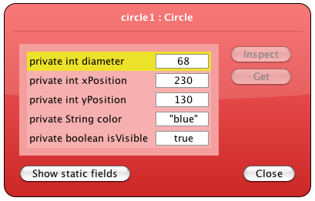
State

Slide 16
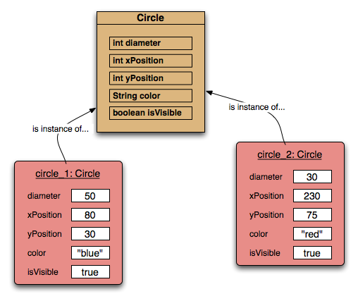
Two Circle objects

Slide 17
Source code
Each class has source code associated with it that defines its details (attributes and methods).
The source code is written to obey the rules of a particular programming language.
We will explore this in detail in the next chapter.

Slide 18
Return values
All the methods in the figures project have void return types; but …
… methods may return a result via a return value.
Such methods have a non-void return type.
More on this in the next chapter.

Slide 19
Review
Classes model concepts.
Source code realises those concepts.
Source code defines:
What objects can do (methods).
What data they store (attributes).
Objects come into existence with pre-defined attribute values.
The methods determine what objects do with their data.

Slide 20
Review
When a method is called an object:
Alters its state, and/or
Uses its data to decide what to do.
Some methods take parameters that affect their actions.
Methods without parameters typically use their state to decide what to do.
Some methods return a value.

Slide 21
Review
Most programs contain multiple classes.
At runtime, objects interact with each other to realize the overall purpose of the program.

